Slide 1
ENSC 450: Final Project
Barry Yim byim@sfu.ca
Cheng Jie (Jadan) Ou jou@sfu.ca
Bonnie Ha bha20@sfu.ca

Slide 2
Outline
Designed a Register File containing 32 16-bit registers in VHDL
First performed Front End design on the Register File, including synthesis and design optimization
After obtaining and charting the results from Front End design we moved on to Back End design with original Register File
After completely finishing Back End design with no design flaws/errors we looked back at Front End design data in order to choose a best and worst configuration for Register File
Using the best and worst configurations we once again ran through Back End design for both configurations
After removing all design violations/errors we conclude on which configuration (best/worst) is better suited for our Register File

Slide 3
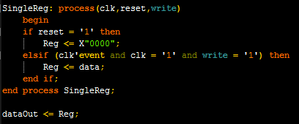

VHDL
Designed 16-bit register with clock, reset and a write (enable)
Created many registers by using the “generate” command
Tested VHDL by successfully writing into and reading out bits from registers

Slide 4
Synthesis Results
Performed optimization in order to realize circuit potential
As can be seen from the graphs above, circuit can be ran at either 286MHz or 40MHz without sacrificing Area or Power
The path of data travel is essentially the same for each register, but some will have longer input and output wires due to the number of registers and will become the Critical Path

Slide 5
Optimization

Slide 6
Place & Route

Slide 7
Constraints

Slide 8
Results

Slide 9
Results (2)

Slide 10
Conclusion

